Slide 1
INTELLIGENT AGENTS
Chapter#2
1

Slide 2
This time: Outline
Intelligent Agents (IA)
IA Behavior
IA Structure
Environment types
IA Types

Slide 3
Human Agent
A human agent has eyes, ears, and other organs for sensors
and hands, legs, vocal tract, and so on for actuators/effectors.

Slide 4
AGENTS AND ENVIRONMENTS
An agent is anything that can be viewed as perceiving its environment through sensors and acting upon that environment through actuators/effectors.
Software Agent
A software agent receives keystrokes, file contents, and network packets as sensory inputs and acts on the environment by displaying on the screen, writing files, and sending network packets.

Slide 5
Intelligent Agents and Artificial Intelligence
Human mind as network of thousands or millions of agents all working in parallel. To produce real artificial intelligence, this school holds, we should build computer systems that also contain many agents and systems for arbitrating among the agents' competing results.
Distributed decision-making
and control
Challenges:
  Action selection: What next action
  to choose
  Conflict resolution
Agency
sensors
effectors

Slide 6
Agent research Strands
We can split agent research into two main strands:
Distributed Artificial Intelligence (DAI) –
Multi-Agent Systems (MAS) (1980 – 1990)
or "self-organized system"
Much broader notion of "agent" (1990’s – present)
  interface, reactive, mobile, information

Slide 7
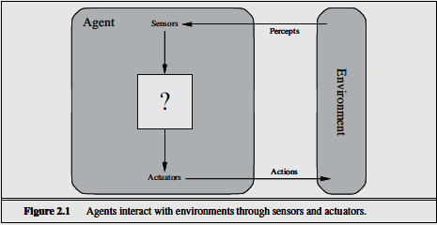
Agent research Strands(Cont..) MAS
The term percept refer to the agent’s perceptual inputs at any given instant. An agent’s percept sequence is the complete history of everything the agent has ever perceived.

Slide 8
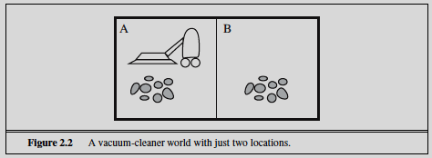
Example
Percepts: Dirt and location
Initial state: Any
Sensors: Electric impulse sensor (bits of dirt hit)
Actions: Left, Right, Suck
Goal: No dirt at all locations https://www.explainthatstuff.com/how-roomba-works.html

Slide 9
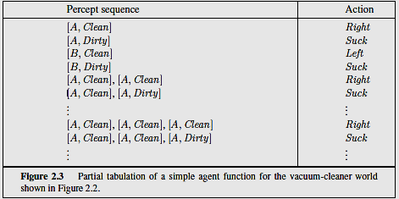

Slide 10
A Windshield Wiper Agent
How do we design a agent that can wipe the windshields when needed?
Goals?
Percepts ?
Sensors/Effectors ?
Actions ?
Environment ?

Slide 11
A Windshield Wiper Agent (Cont’d)
Goals: To keep windshields clean and maintain good visibility
Percepts: Raining, Dirty
Sensors: Camera (moist sensor)
Effectors: Wipers (left, right, back)
Actions: Off, Slow, Medium, Fast
Environment: Inner city, freeways, highways, weather …

Slide 12
Mobile agents
Programs that can migrate from one machine to another.
Execute in a platform-independent execution environment.
Require agent execution environment (places).
Mobility not necessary or sufficient condition for agenthood.
Practical but non-functional advantages:
  Reduced communication cost (eg, from PDA)
  Asynchronous computing (when you are not connected)
Two types:
  One-hop mobile agents (migrate to one other place)
  Multi-hop mobile agents (roam the network from place to place)
Applications:
  Distributed information retrieval.
  Telecommunication network routing.

Slide 13
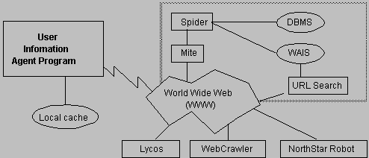
Information agents
Manage the explosive growth of information.
Manipulate or collate information from many distributed sources.
Information agents can be mobile or static.
Examples:
  BargainFinder comparison shops among Internet stores for CDs
  Internet Softbot infers which internet facilities (finger, ftp, gopher) to use and when from high-level search requests.
Challenge: ontologies for annotating Web pages (e.g, SHOE).

Slide 14
Structure of Intelligent Agents
Agent = architecture + program
Agent program: the implementation of f : P* → A, the agent’s perception-action mapping
function: Skeleton-Agent(Percept) returns Action
memory ← UpdateMemory(memory, Percept)
Action ← ChooseBestAction(memory)
memory ← UpdateMemory(memory, Action)
return Action
Architecture: a device that can execute the agent program (e.g., general-purpose computer, specialized device, beobot, etc.)

Slide 15
The Right Thing = The Rational Action
The rationality at any given time depends on four things:
• The performance measure that defines the criterion of success.
• The agent’s prior knowledge of the environment.
• The actions that the agent can perform.
• The agent’s percept sequence to date.
Definition of a Rational agent:
For each possible percept sequence, a rational agent should select an action that is expected to maximize its performance measure, given the evidence provided by the percept sequence and whatever built-in knowledge the agent has.

Slide 16
The Right Thing = The Rational Action
  Rational = Best ?
  Rational = Optimal ?
  Rational = Omniscience ?
  Rational = Learning ?
  Rational = Autonomous?
  Rational = Best Yes, to the best of its knowledge
  Rational = Optimal Yes, to the best of its abilities (incl. its constraints)
  Rational ≠ Omniscience Omniscient agent knows the actual outcome of its actions and can act accordingly
  Rational ≠ Learning Not only to gather information but also to learn as much as possible from what it perceives.
  Rational ≠ Autonomous Relies on the prior knowledge rather than its on percept

Slide 17
Specifying the task environment
Problem specification: Performance measure, Environment, Actuators, Sensors (PEAS)
Example: automated taxi driver
Performance measure Safe, fast, legal, comfortable trip, maximize profits
Environment Roads, other traffic, pedestrians, customers
Actuators Steering wheel, accelerator, brake, signal, horn Steering wheel, accelerator, brake, signal, horn
Sensors Cameras, sonar, speedometer, GPS, odometer, engine sensors keyboard engine sensors, keyboard

Slide 18
Environment Types
  Fully observable (vs. partially observable): The agent's sensors give it access to the complete state of the environment at each point in time
  Deterministic (vs. stochastic): The next state of the environment is completely determined by the current environment is completely determined by the current state and the agent’s action
  – Strategic: the environment is deterministic except for the actions of other agents
  Episodic (vs. sequential): The agent's experience is divided into atomic “episodes,” and the choice of action in each episode depends only on the episode itself

Slide 19
Environment Types
Static (vs. dynamic): The environment is unchanged while an agent is deliberating
– Semi dynamic: the environment does not change with the passage of time, but the agent's performance score does
Discrete (vs. continuous): The environment provides a The environment provides a fixed number of distinct percepts, actions, and environment states
–Time can also evolve in a discrete or continuous fashion
Single agent (vs. multi-agent): An agent operating by itself in an environment
Known (vs. unknown): The agent knows the rules of the environment

Slide 20
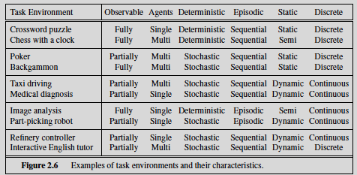
Examples of different environments

Slide 21
Agent types
Reflex agents
Model based Reflex agents
Goal-based agents
Utility-based agents

Slide 22
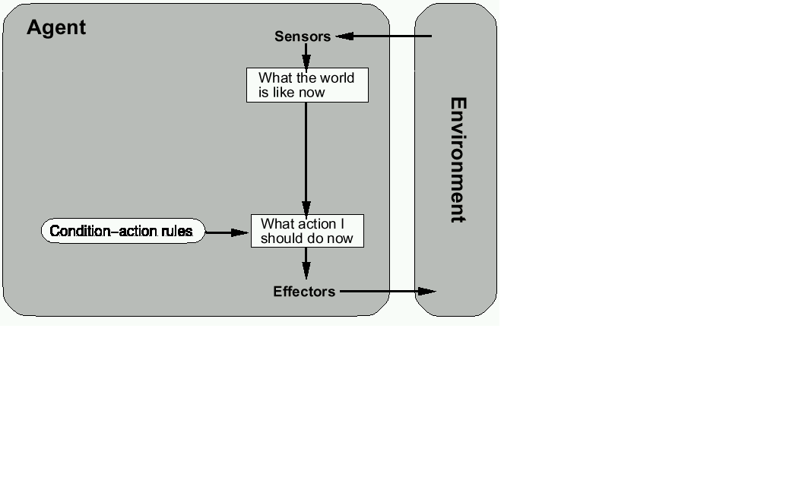
Simple Reflex agents
Select action on the basis of current percept, ignoring all past percepts

Slide 23
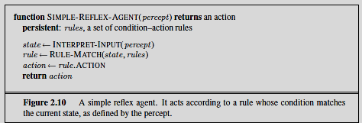
Simple Reflex agents

Slide 24
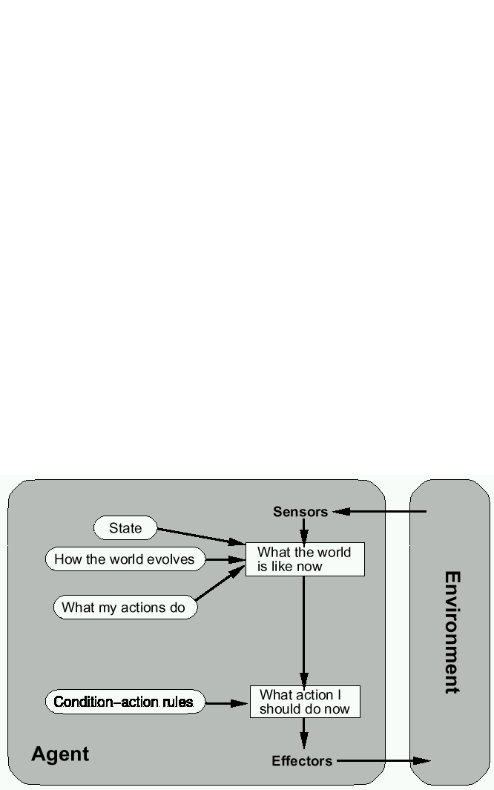
Model based Reflex agents
Maintains internal state that keeps track of aspects of the environment that cannot be currently observed

Slide 25
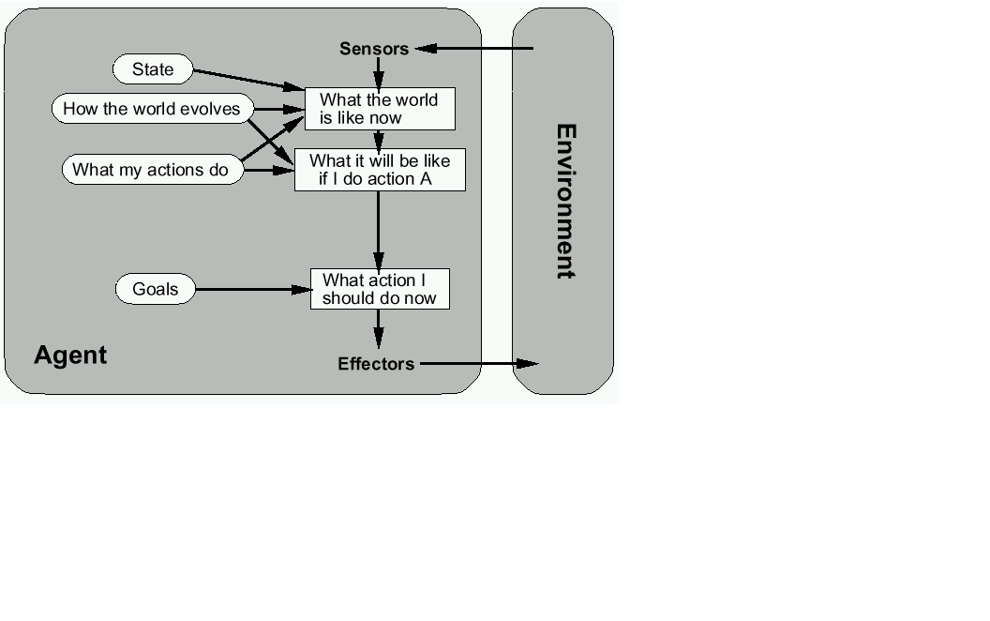
Goal-based agents
The agent uses goal information to select between possible actions in the current state

Slide 26
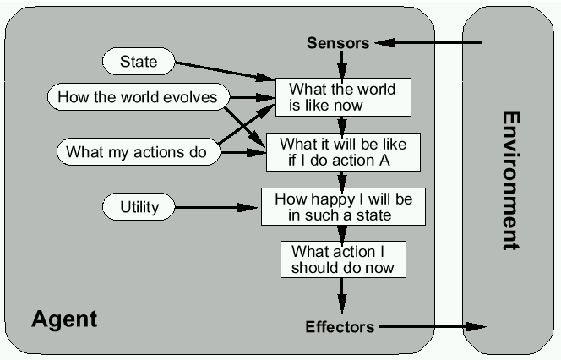
Utility-based agents
The agent uses a utility function to evaluate the desirability of states that could result from each possible action

Slide 27
Summary
Intelligent Agents
IA Behavior
IA Structure
Environment types
Agent Types: Reflex, state-based, goal-based, utility-based

